Slide 1
Welcome to the
Information and
Content Management
PRESENTATION
Md. Abid Hossain
Final Year Student (Computing)
University of Greenwich

Slide 2


This presentation includes
A clone of the international NGO
Designed using a CMS
5 Main Pages in the clone website

Slide 3
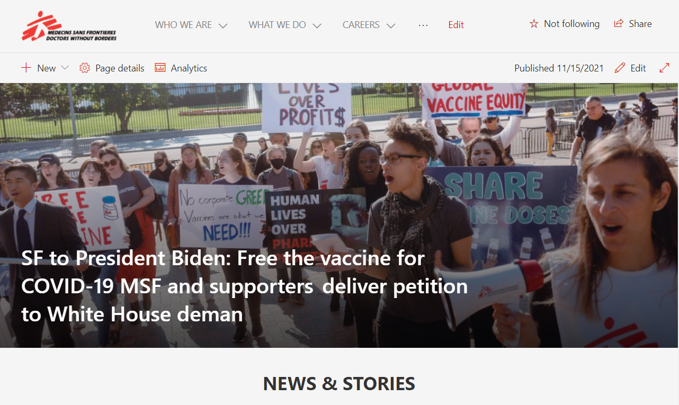
Home

Slide 4
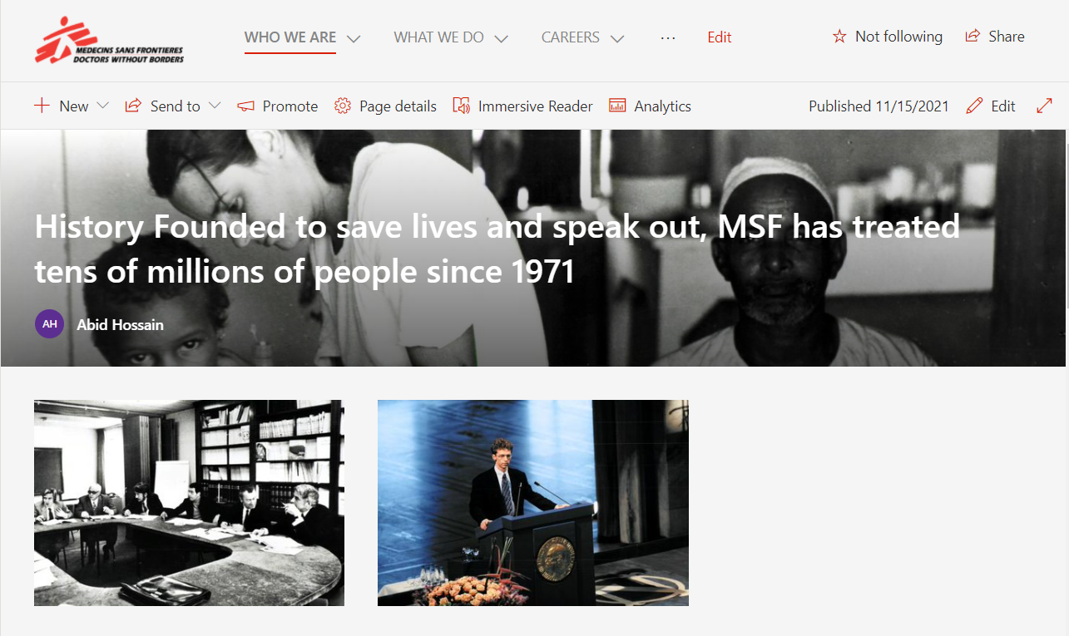
History (About)

Slide 5
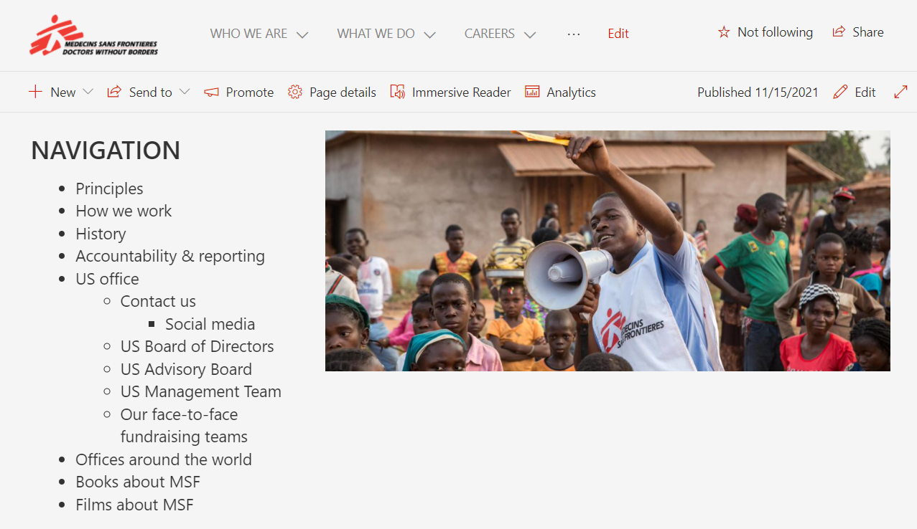
Contact Us

Slide 6
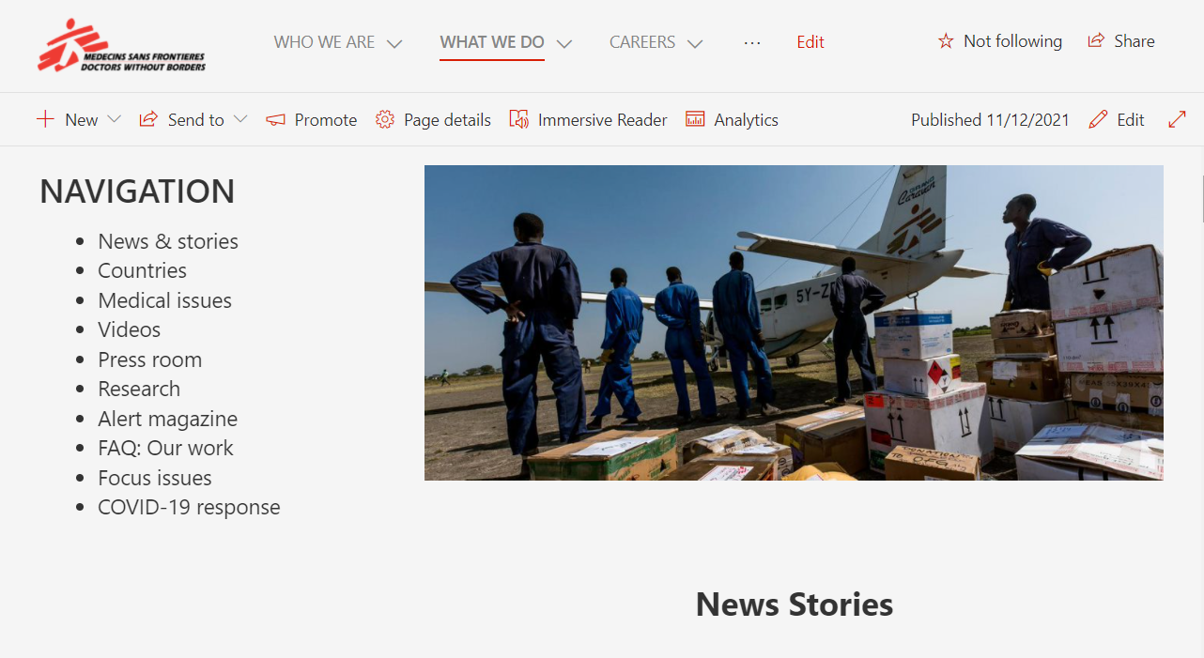
News and Stories (Blog)

Slide 7
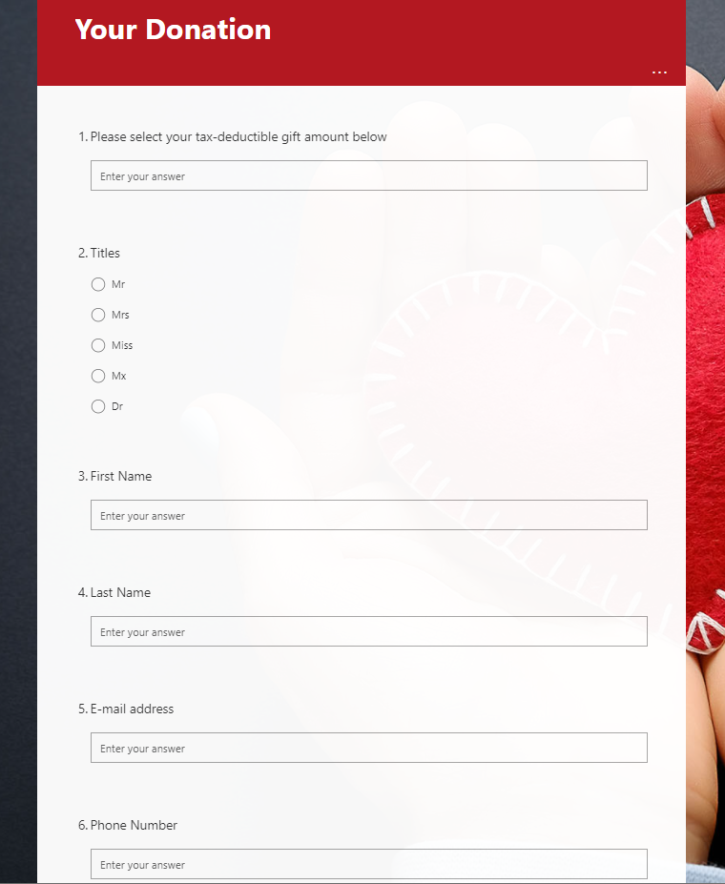
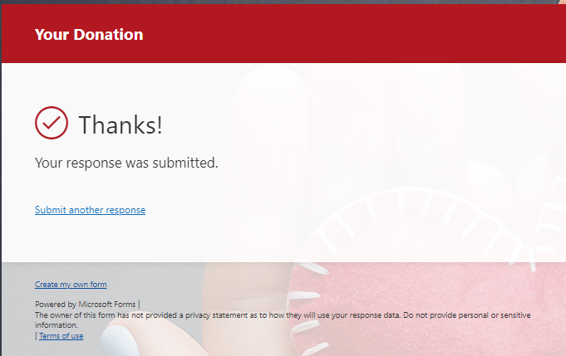
Donate

Slide 8
Roles I have played in this project
Scrum Master
Analyst
Arrange meetings for self evaluation, maintain backlogs and guide myself to overcome obstacles.
Analyze the user needs and specify the requirements and specifications for the developers.
Developer
Designer
Develop the solution using SharePoint CMS and complete all the functionalities.
Analyze the UI of the NGO website and come up with an optimal design solution.
Tester
Find errors and bugs in my work more efficiently and take security measures if necessary.

Slide 9
Thank you
Notes:
https://unsplash.com/photos/bJjsKbToY34

